Slide 1

How a Better Understanding of the Church Will Develop Members Missiologically in a Digital Age
Lane Willis

Slide 2

Who am I?
MDiv Student in Missiology
Desire to Go Overseas to Participate in the Missionary Task
Work in the Center for Great Commission Studies and have recently been looking at how churches develop a sending culture.
Notes:
Tell a little bit about myself and how I became interested in this topic. Why does this matter to me?

Slide 3

Three Questions
What makes a church a church?
How does our definition of church provide us with a framework for missions?
How does our framework help us answer thorny missiological questions in a digital society?
Notes:
As I have been a student at SEBTS and worked in the CGCS, three main questions have arisen and driven my research. They are:
Read Slide.
Tease thorny questions: metaverse "church", digital tools to develop sending culture.
Transition: As I considered these questions, I began to define a problem.

Slide 4
Problem - "Lack of Going"
Church members have a deficient understanding of church (ecclesiology). This inhibits churches and church members from moving outward in evangelism, discipleship, and sending (missiology).
Notes:
This problem is a lack of going. By this, I mean that most church members will struggle to move outward to their neighbors and family to share the love of Christ. Why is this?
I theorize that "READ SLIDE."
So, if this is our problem, how might we fix this?

Slide 5
So, how might we fix this?
We must teach our members to have a more robust understanding of the church (ecclesiology) that includes the fact that churches are ontologically sent by God to be witnesses to the ends of the earth.
Notes:
I propose the following:
Read slide. I believe that if our members understood more about what it means to be the church, we would be better equipped to send members out!
What might this result in?

Slide 6
What might this result in?
This could propel members forward in evangelism, discipleship, and sending (missiology).
This might help us better answer thorny missiological questions that are presented by some of the new frontiers in a digital society.
Notes:
What might this result in?
READ SLIDE.
But why does this even matter?

Slide 7

Why does this matter?

Slide 8
3.4 Billion.
42.4%.
Joshua Project
“People Groups of the World | Joshua Project.” 2024. Accessed March 5, 2024. https://joshuaproject.net/.
Notes:
As we think about the reality of this number, and how large it is, it should create some urgency in us and in our congregations. Yet, why are people still not going? Let me remind you of my premise, that church members need to develop a better ecclesiology, which in turn might result in more EV, DISC, and sending. This also hopefully results in being able to answer thorny missiological questions!
So let's jump in to a discussion of ecclesiology.

Slide 9
What Makes a Church a Church?
The people?
The building?
The size?
Is a church defined by its goals, characteristics, or functions?
Notes:
This is a question of ontology, of being. Over the next few slides, I will discuss ontological characteristics that will help us build a framework for interpreting thorny missiological questions.
Before doing so, I want to show you a secular definition.

Slide 10
"A church is a building, the officialdom of a religious body, a body or organization or believers, or a public divine worship space."
Merriam-Webster Dictionary
Notes:
When typing church into google, this is just one of the many definitions that may come up.
READ DEFINITION.
Even as we look at this definition, there is confusion about what the church is supposed to be and do. If we do not help our members come up with a better definition of church, this is what they may end up with.

Slide 11
Theological Perspectives on Church
Payne's House Church
Dever's Nine Marks
Allison's Seven Attributes
Baptistic Church
Hammett's Seven Characteristics
Acts 2
Notes:
Today, I am going to delineate quickly 7 different perspectives and definitions of church. I will then attempt to synthesize these into a rubric of sorts and then use that rubric to deal with thorny missiological questions.
The seven are as follows: list the seven.

Slide 12
Acts 2
Christocentric
Conversion
Apostolic Teaching
Fellowship
Prayer
Spirit-Empowered
Ordinances
Worship
Reproduction
Notes:
Devoted to the Fellowship…

Slide 13
Payne's House Church
Organic
Simple
Participatory
Community-driven
Celebrate equality in ministerial roles
J. D. Payne, Missional House Churches: Reaching Our Communities with the Gospel (Colorado Springs;
Milton Keynes, U.K.: Paternoster, 2008), 38–42.

Slide 14
Dever's Nine Marks
Preaching
Biblical Theology
The Gospel
Conversion
Evangelism
Membership
Discipline
Discipleship
Leadership
Dever, Mark, and H. B. Charles. 2021. Nine Marks of a Healthy Church. 4th edition. Crossway.

Slide 15
Hammett's Seven Characteristics
God's
Organized
Purposeful
Local
Living
Spirit-Empowered
Gospel-Centered
Hammett, John S. 2019. Biblical Foundations for Baptist Churches: A Contemporary
Ecclesiology. Updated & Expanded edition. Grand Rapids, MI: Kregel Academic.

Slide 16
Allison's Seven Attributes
Doxological
Logocentric
Pneuma-dynamic
Covenantal
Confessional
Missional
Spatio-Temporal/Eschatological
Allison, Gregg R. 2012. Sojourners and Strangers: The Doctrine of the Church. Edited by John S. Feinberg.
1st edition. Wheaton, IL: Crossway.

Slide 17
Baptist Church
“An autonomous local congregation of baptized believers, associated by covenant in the faith and fellowship of the gospel; observing the two ordinances of Christ, governed by His laws, exercising the gifts, rights, and privileges invested in them by His Word, and seeking to extend the gospel to the ends of the earth. Each congregation operates under the Lordship of Christ through democratic processes. In such a congregation each member is responsible and accountable to Christ as Lord.”
SBC. 2000. “Baptist Faith & Message 2000 - The Baptist Faith and Message.” Https://Bfm.Sbc.Net/.
Accessed April 4, 2023. https://bfm.sbc.net/bfm2000/.

Slide 18
Framework
Doxological
Spirit-Empowered
Sent
Gospel-Centered
Local
Notes:
After reviewing the seven definitions above, I will synthesize them into the following 5 characteristics:

Slide 19
Doxological
Doxological
His
Centered on the Father
Worship/Awe produced
Lordship of Christ
Notes:
Focus on the glory of God. Is God's.

Slide 20
Gospel-Centered
Biblical Theology/The Gospel
Logocentric/Confessional
Christocentric
Conversion
Notes:
The core confession that ties us together as believers is that Jesus is Lord. We are centered around the Christ and Scripture. We believe in the conversion of the saints and that those who are a part of the family are a part of the body.

Slide 21
Spirit-Empowered
Spirit-Empowered
Pneuma-dynamic
Holy Spirit directing the Work (Acts 2)
Notes:
In Acts, we see the church led along by the power of the Holy Spirit. We must recognize that we can do nothing apart from God's illuminating power in the Holy Spirit. Catholics' emphasize this by highlighting how the church should be holy.

Slide 22
Local
Community-Driven/Participatory
Local (Twice)
Membership/Discipline
Fellowship
Spatio-Temporal/Covenantal
Notes:
Allison: "Scripture indicates that specific churches were established in specific places with concrete addresses."

Slide 23
Sent
Missional
Purposeful
Evangelism/Discipleship
Extend the Gospel to the Ends of the Earth
Reproducing

Slide 24
Framework
Doxological
Spirit-Empowered
Sent
Gospel-Centered
Local
Notes:
Highlight how this is for a local expression of a church, not universal church.
Now that we have gone over a synthesis, let us now apply these five principles to thorny missiological questions.

Slide 25
Contemporary Missiological Implications
Digital Services
Metaverse Church
Sending Culture
Notes:
How does our framework help develop a sending culture? Highlight again how this definition includes the word sent. Ensure that our teachings do not miss out on this important principle.
How does the framework help advise us in utilizing tools for creating sending cultures?
Similarly, how does this framework help advise us in utilizing tools for training and coaching missionaries and indigenous leaders?
We must capitalize on technology to better equip those around the globe.
However, our training cannot just include digital components, but must include local components of missionaries and indigenous leaders getting out into the field.
What does this teach us about digital services?
They must be connected to a local physical church in some way. There has to be some concrete address.
What does this teach us about a "church in the metaverse?"
With the framework provided, I would not call a meeting in the metaverse church. I might call it an online fellowship, but I do not want to utilize the word church or devalue it in some way because it is not local or embodied.
Why does this discussion need to be had?

Slide 26
Billions of Active Gamers
171 Million people in VR
Jeff Reed
Reed, Jeff. 2023. “Meeting God in the Metaverse.” Evangelical Missions Quarterly 59, no. 3 (September): 38–42.
Notes:
Emphasize the global reach of the internet and how the church has missed opportunities here.
Emphasize the vast lostness of these people as well. As I was reading, I came across a study by Do-Hoon Kim from 2013 that stated 97% of those in the metaverse were unchurched. This is a crazy statistic that emphasizes the lostness of this digital field.

Slide 27
Current Examples
VRChurch
Life Church
Completely Online
Phygital Church
Hybrid Church
Little Hills Church
Resources for Launching Online
TheChurch.Digital
Notes:
As early as 2012, movements were being started in the metaverse. This started with a young kid on Roblox who wanted to live out his faith online. Today, as technology has evolved, metaverse church has become trendy and seemingly necessary. Here are a few examples of churches who are attempting to live out their Christian faith in online ways.
According to my framework, the last two would be churches with online interfacing. This online interfacing is supposed to move outward in physical, local gatherings.
The first example is completely online. It is a digital space where those online interact and attempt to have fellowship.

Slide 28
Future Case Studies
Raleigh
Kenya
Ethiopia
Notes:
Future areas of interest and intersection for me are in the Raleigh/Wake Forest area, in Kenya, and in Ethiopia. These are places I have been able to witness the movement of the church and how God is raising up missionaries to go. I would be interested to see how technology is affecting these three areas differently.

Slide 29
Future Questions to Consider
What is the full scope of the VR "Church"?
Can it be used in countries where believers cannot gather? Is this a useful bridge?
Will the transition to VR get to a place where someone lives in that reality (like Ready Player One)? If so, we must have a plan to undertake missions in the metaverse.
How can we utilize VR to train indigenous leaders by extension? Is this feasible?
Have we missed out on the video game/movie/metaverse arena for too long? Can we catch up?
What does it mean for someone to be present or local? Can an avatar count as being present? Or does it need to be my physical body?
How are the ordinances observed? Is this even possible?
Notes:
Guichun Jun, "It is absolutely necessary that VR churches need to collaborate with the traditional churches to develop their theological foundations as well as to overcome ministerial limitations and challenges (Kim, 172–173). Furthermore, it is urgently requested that the traditional churches need to plan more sound VR churches as there are already spurious churches in VR."

Slide 30
Conclusion
We must cultivate a mindset of looking out instead of looking in, so that all might hear! The need is great.
We must seek to teach a more robust ecclesiology to our members. If we do this, we might encourage sending and we might be able to better navigate thorny issues in the digital age.
Lastly, when we teach our members about ecclesiology, we must choose a definition of the local church that highlights the ontological nature of the church as doxological, gospel-centered, Spirit-empowered, local, and sent.

Slide 31

Questions?

Slide 32
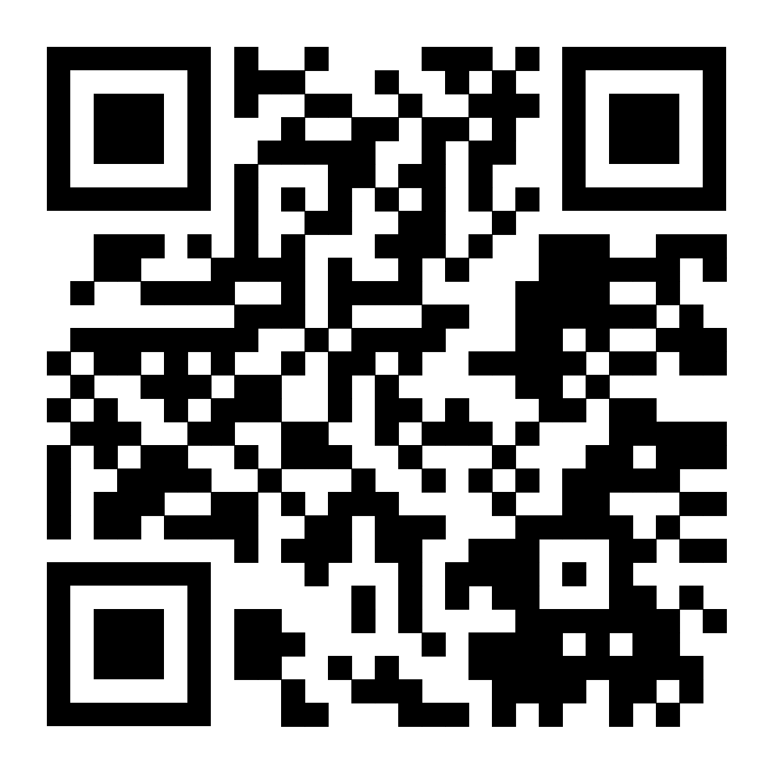
Works Consulted

